Slide 1

Research Question – Is there a correlation between the magnitude and depth of earthquakes in Greece over the past 58 years? Date:
Names of Student Attendees (all group should attend to get feedback): Marvah Mushtaq, Ali Hussain Gardezi, Talat Hussain, Kusuma Reddy, Saba Shaikh.
Group Name: A005 Name of Student Presenting: Marvah Mushtaq

Slide 2
This dataset is interesting to us because: It is covering the years 1965 to 2023, offering a clear view of trends and patterns of earthquakes overtime. It includes information on where and when each earthquake happened, how strong it was, and how deep below the surface has occurred. Our Independent variable is : depth This Independent variable datatype is : Interval/Measurement data Our Dependent variable is : magnitude This Dependent variable datatype is : Interval/Measurement data
Names of Student Group Attendees: Marvah Mushtaq, Ali Hussain Gardezi, Talat Hussain, Kusuma Reddy, Saba Shaikh.
Dataset ID: DS146 – Greece’s Earthquakes
Notes:
Before specifying your Research Question you must define the type of data you are analysing. Are the variables you select interval data (measurement data you can divide, multiple, etc), OR are they ordinal (there is a definite order but the intervals between each variable are not necessarily equal, or the terms might be subjective like in a likert scale); OR are they just categorical/nominal (Items such as film names, cities, etc., that you can count numbers of occurrences? You also need to understand whether the variable is either dependent or independent and this will vary according to the context. Independent variables may cause an effect, whereas the dependent variable might be effected by the independent variable. Check the lecture notes on the RQ for more information and examples.
You will get only one opportunity to present your Research Question ahead of the submission date. Have your questions ready, and be ready to take notes on feedback.

Slide 3
1. Null hypothesis (H_{o}): there is no effect in the population - Null hypothesis (H_{o}): there is no correlation between magnitude and depth of the earthquakes that have occurred in Greece over the past 58 years. . 2. Alternative hypothesis (H₁); there is an effect in the population - Alternative hypothesis (H₁); there is a correlation between the magnitude and depth of the earthquakes that have occurred in Greece over the past 58 years.

Slide 4
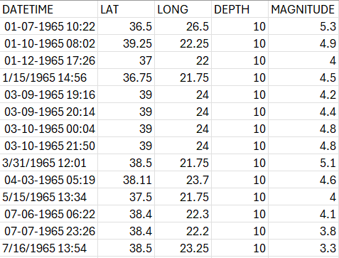
Dataset – your data?

